Slide 1



AI-Enabled Digital Forensics for
Additive Manufacturing
PROF. GREG GIBBONS
ISHAN KANODIA
PROF. DIMITRY ISAKOV

Slide 2

CONTENTS
01 | WHAT IS ADDITIVE MANUFACTURING
02 | CONCEPT OF FINGERPRINTS
03 | PROCEDURE
04 | FEATURES USED FOR THE DATA
05 | EXPERIMENT
06 | RESULTS
07 | INFERENCES AND CONCLUSION

Slide 3
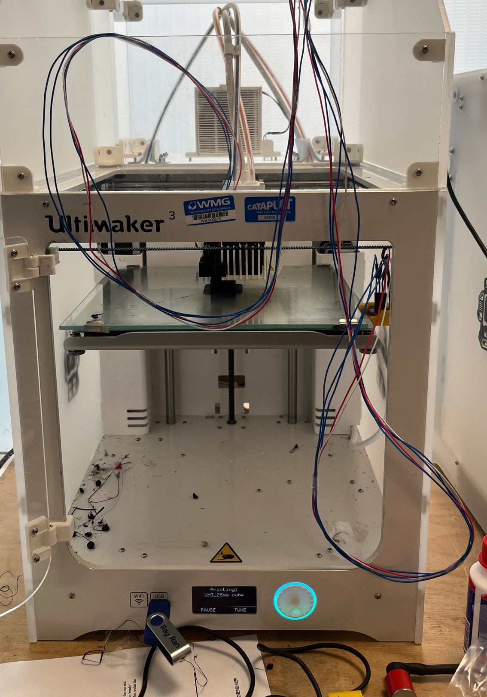
01
Additive manufacturing builds 3D objects by successively adding and fusing material in thin layers, guided by a digital 3D model
ADDITIVE
MANUFACTURING
02
The process supports a wide array of materials, including plastics, metals, and ceramics. This enables the creation of highly intricate designs
Saying this in a simple line, additive manufacturing is the repetitive manufacturing or layer by layer construction best example being 3d printing
03
Additive manufacturing minimizes material waste by building only the required shape. It facilitates rapid prototyping and on-demand production

Slide 4


FINGERPRINTS
Every 3D printer has a unique fingerprint through which they might be distinguished and these might be texture, thermal, vibrational etc.
Reference Paper: Li et al 2018 - PrinTracker - Fingerprinting 3D Printers using Commodity Scanners
As 3D printing technology begins to outpace traditional manufacturing, malicious users increasingly have sought to leverage this widely accessible platform to produce unlawful tools for criminal activities. Therefore, it is of paramount importance to identify the origin of unlawful 3D printed products using digital forensics.
Goal
To identify co-relations among various features and temporal data to understand fingerprints

Slide 5
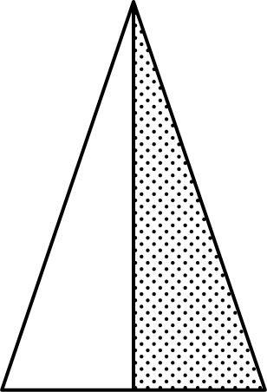
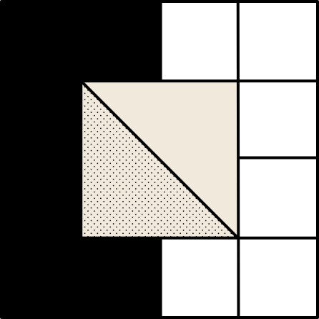
Procedure
The complete process in steps
Choose features and test shapes to print
Setup parts and the 3D printer with Arduino UNO
Conduct the experiment and take the readings
Analyse the Data and produce the results

Slide 6
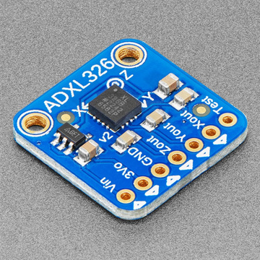
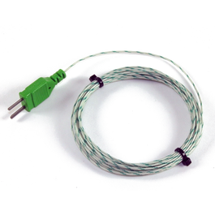
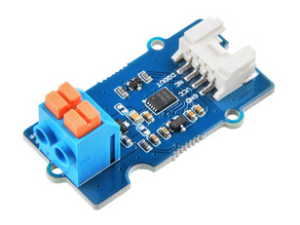
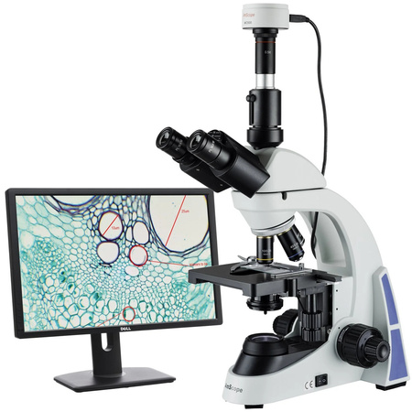
Features considered
The features we considered for our experiment
Instruments used
Vibrations of nozzle and platform during the print
We are taking the readings of the accelerations of nozzle and platform so as to understand the spatial movement of the nozzle while printing different shapes
Accelerometer
Temperature of nozzle during the print
We are taking the readings of the temperature of the nozzle during the print so as to understand how the temperature varies temporally during the print
Thermocouple and
Thermocouple amplifier
Texture of surface after the experiment
After the print, we are taking the image of texture of the specimen so as to understand the differences in prints of same and different printers
Digital microscope with camera

Slide 7
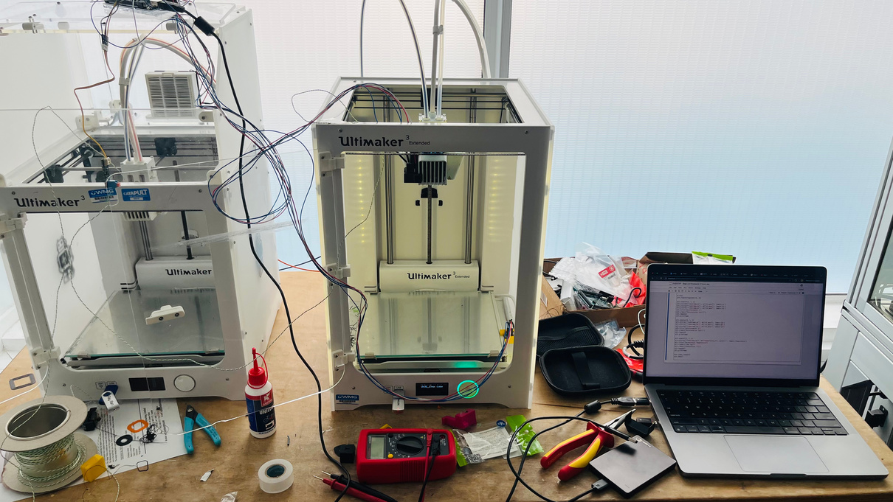

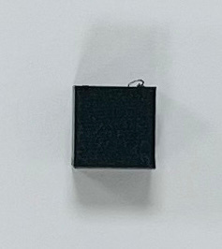
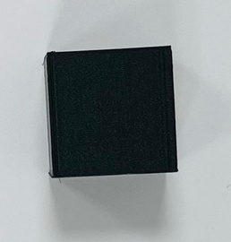
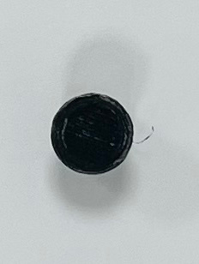
Experiment
Experimental setup
Accelerometer and Thermocouple
Arduino UNO
Jupyter Notebook
ULTIMAKER S3
ULTIMAKER S3 EXTENDED
JUPYTER
NOTEBOOK
CSV file
Cube(10mm)
Cube(25mm)
Cylinder
Data Analysis
Shapes printed

Slide 8
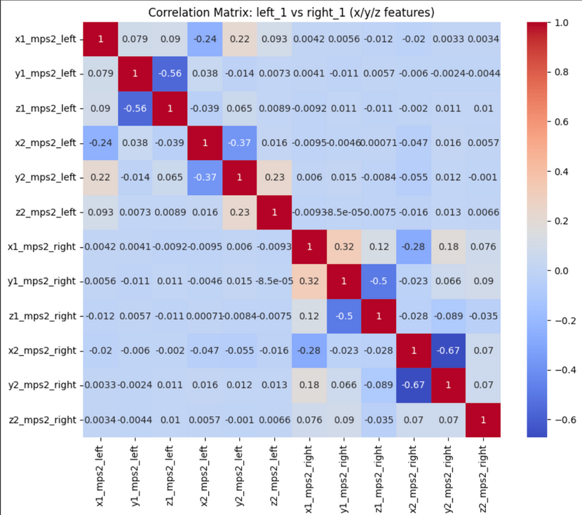
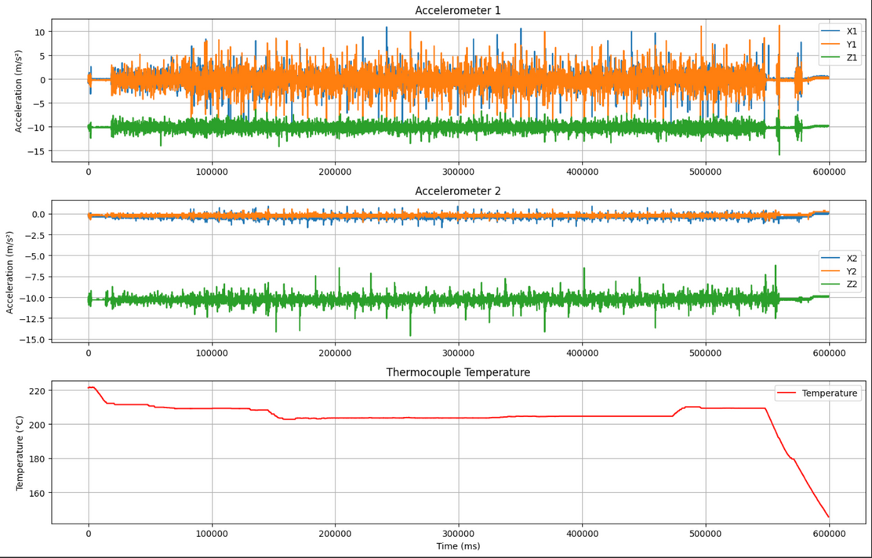
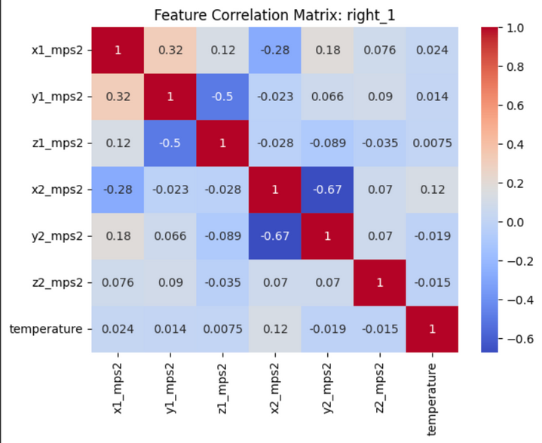
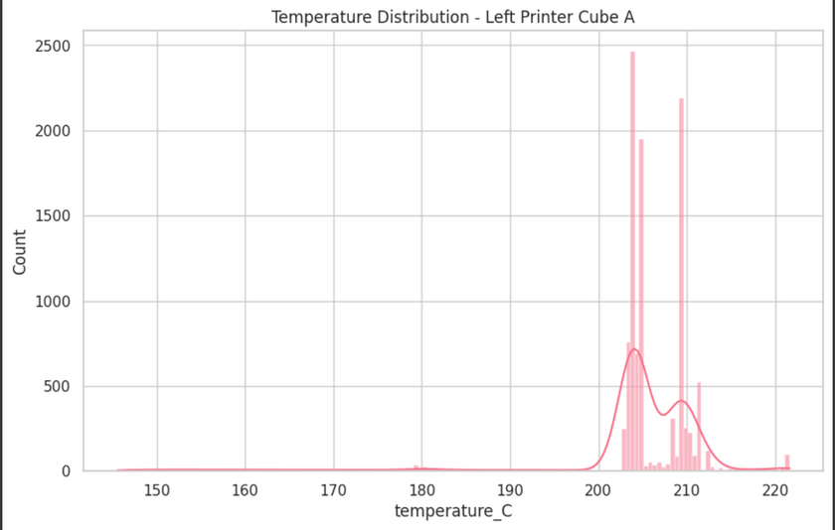
Results

Slide 9
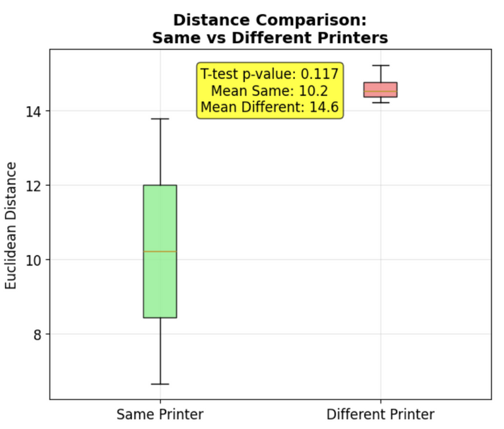
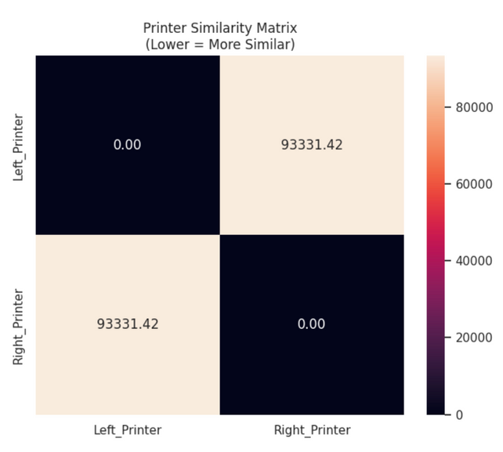
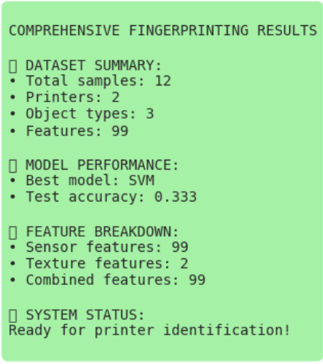
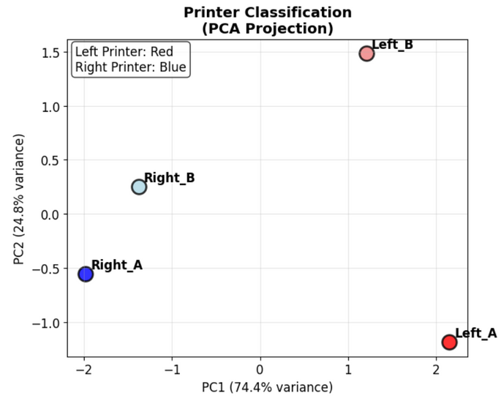
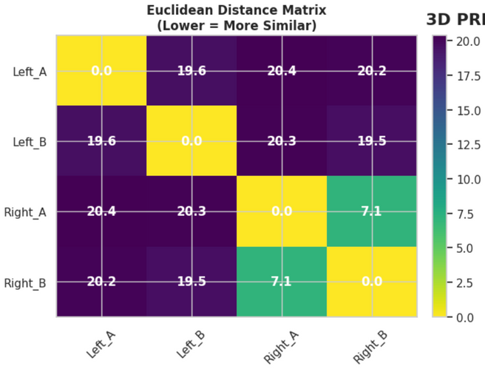
Results

Slide 10
Conclusion
Unique Fingerprints of 3D Printers
Each 3D printer leaves a distinct "fingerprint" based on its mechanical and thermal behavior. This is observable through differences in vibration patterns, temperature profiles, and surface textures.
Key Findings
Vibration data showed distinct motion signatures for different printers, even when printing the same shape.
Thermal readings revealed varying heat flow and stability across devices.
Microscopic texture analysis exposed layer inconsistencies that help identify the printer.
Forensic Implications
These features can be used to:
Trace the origin of 3D printed parts.
Detect unauthorized or counterfeit prints.
Support forensic investigations in criminal cases involving 3D printed tools.
Future Scope
Expand dataset with more printers and complex shapes.
Apply machine learning for automated classification.
Improve robustness against environmental variation.

Slide 11


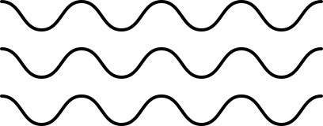
Special thanks to
Prof. Greg Gibbons
Thank you
Prof. Dimitry Isakov
Dr. Sumit Hazra
Dr. Arnab Palit
Dr. Aru Ranjan Singh

